Slide 1
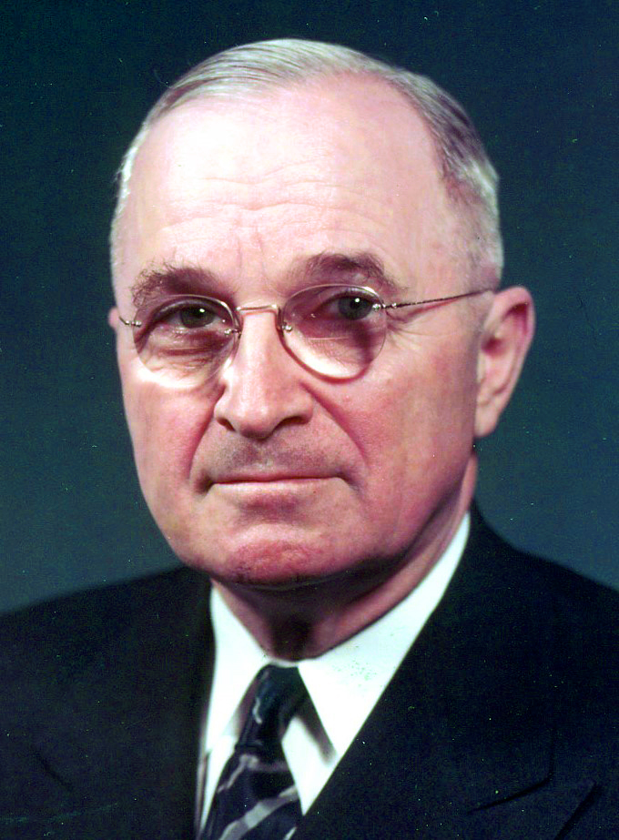
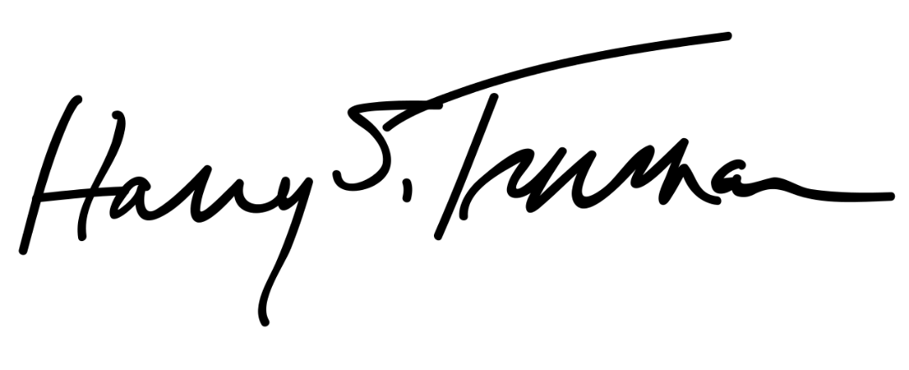
Harry S Truman

Slide 2
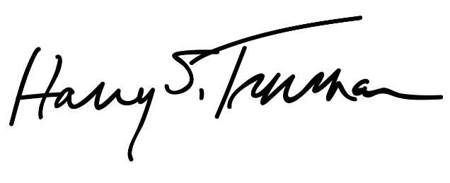
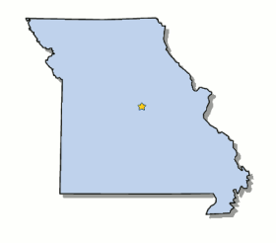
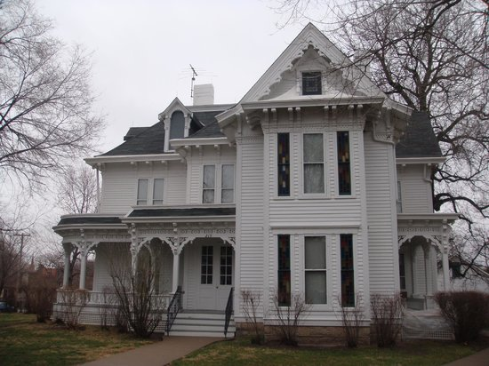
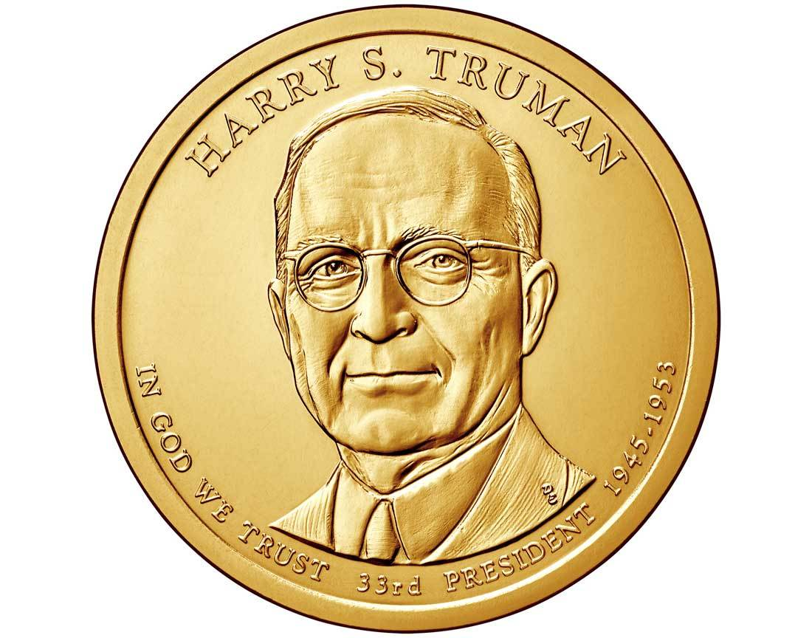
Elected in: 1948
President from: 1945-1953
Political Party: Democrat
Home State: Missouri

Slide 3
New States
None

Slide 4
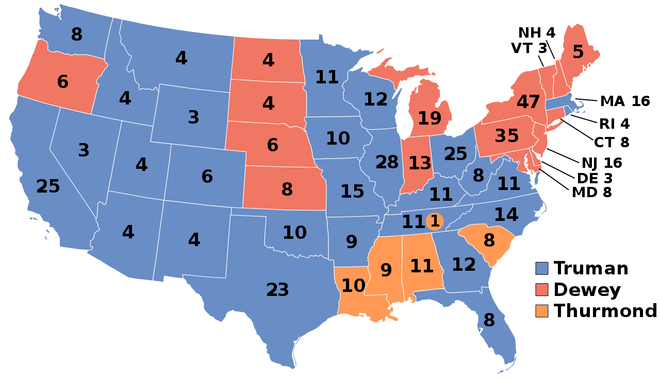
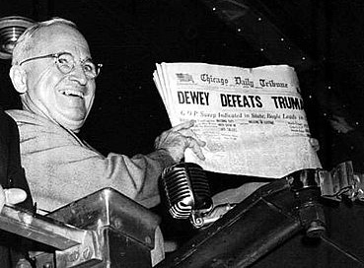
Election of 1948
Democrat: 303
President: Harry Truman
Vice President: Alben Barkley
Republican: 189
President: Thomas Dewey
Vice President: Earl Warren
Dixiecrat: 39
President: Strom Thurmond

Slide 5
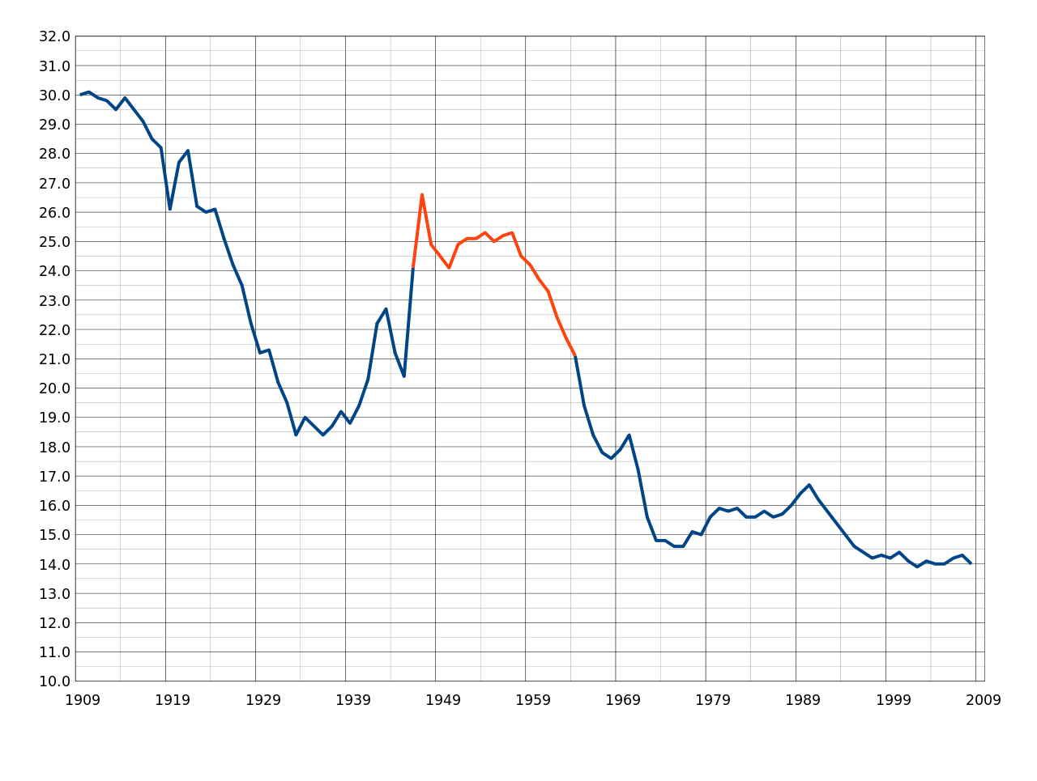
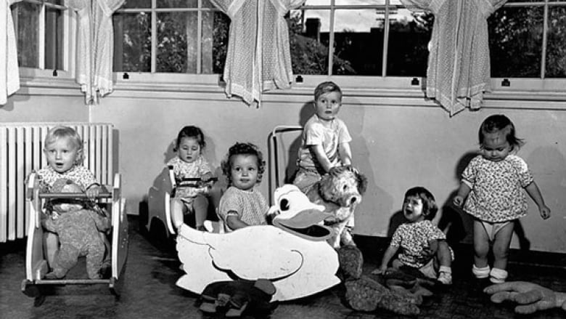
The Baby Boom
The rise in the US birth rate between 1946 and 1964 as soldiers returned home and started families.
78.3 million American born

Slide 6
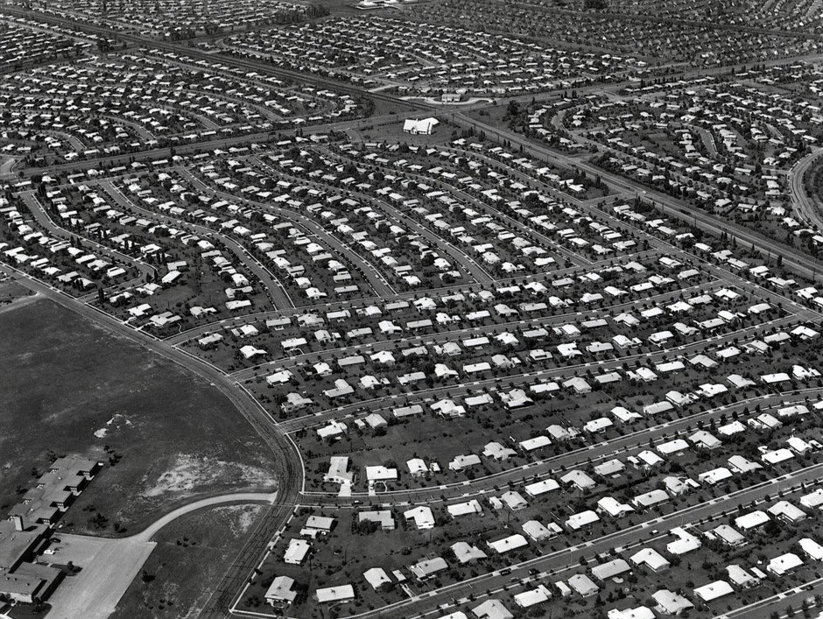
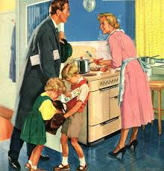
Levitttowns

Slide 7
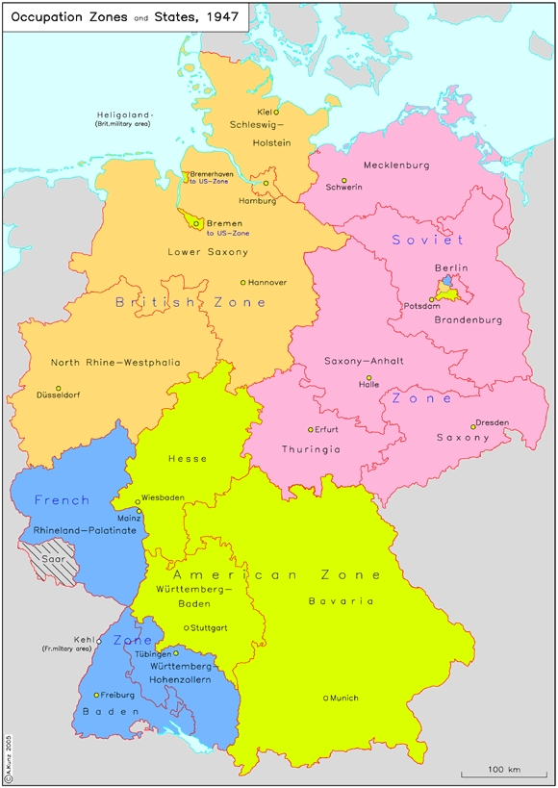
Potsdam Conference & Germany
At the Potsdam Conference, Allied leaders agreed to divide Germany into 4 zones occupation: American, British, French, and Soviet Sectors
Berlin, the capital, would also be divided up into the same four sectors.
By 1949 the three western sectors had been allowed to become West Germany, with the Soviet Communist sector becoming East Germany, surrounding West Berlin.

Slide 8
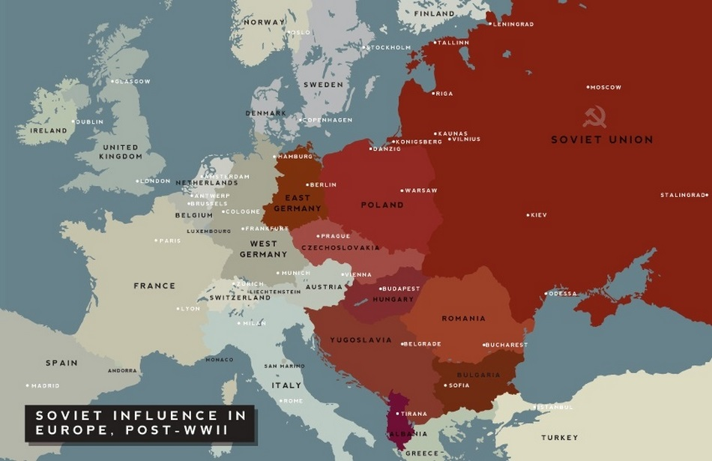

Slide 9
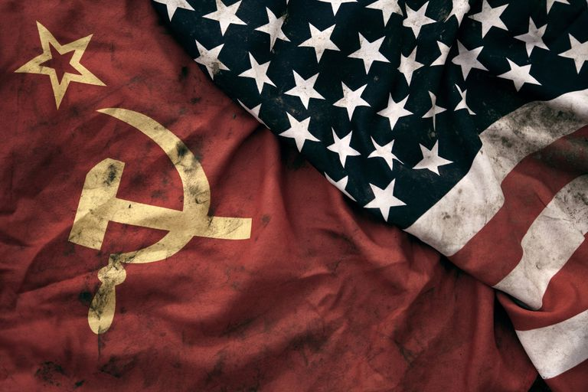
The Cold War
1946-1991

Slide 10
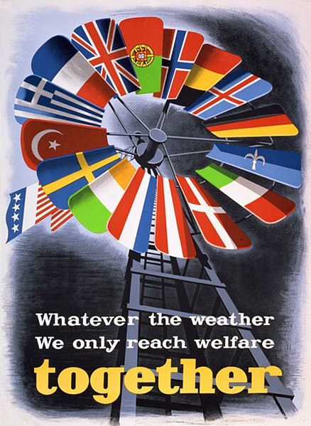
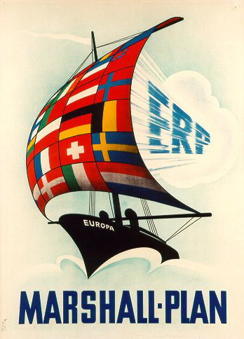
The Marshall Plan - 1948
European Recovery Plan:
U.S.-sponsored program designed to rebuild the economies of 17 western and southern European countries in order to create stable conditions in which democratic institutions could survive in the aftermath of World War II.
Cost: $15 billion

Slide 11
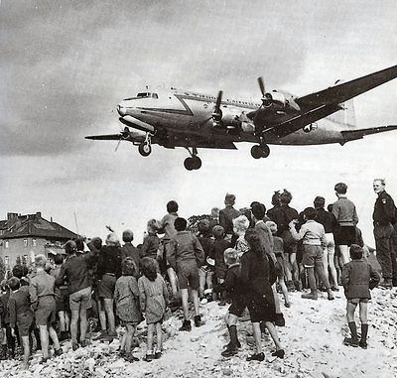
Berlin Airlift 1948-1949
After the Communists blockade West Berlin, the US and UK kept the West Berliners supplied with food and coal, an operation known as the Berlin Airlift.
The Soviet Union gave up the blockade in May 1949.

Slide 12
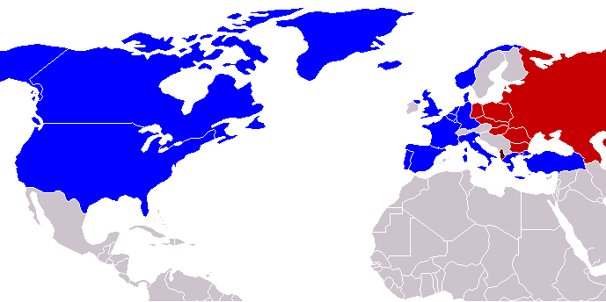
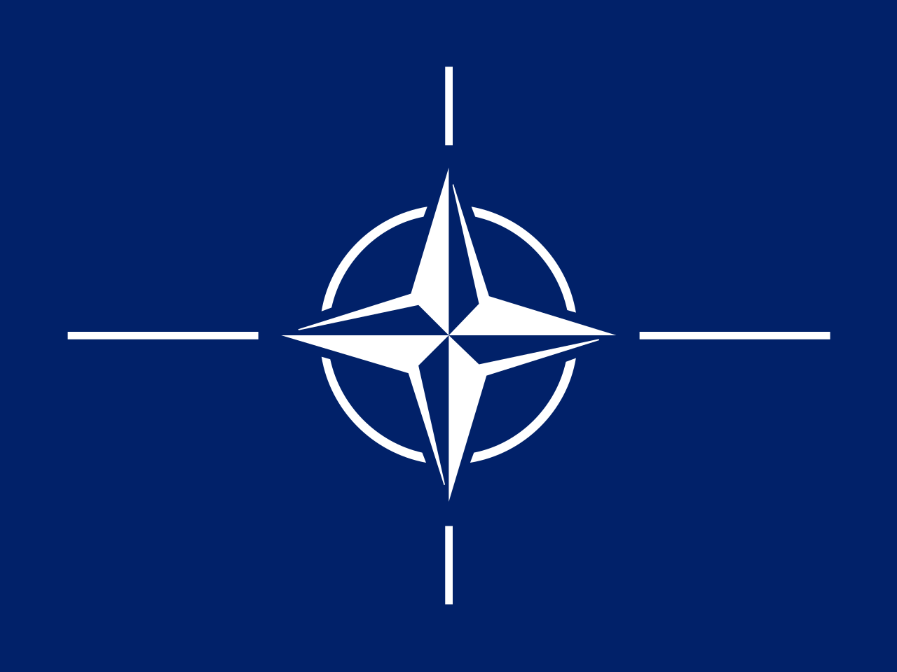
NATO vs Warsaw Pact
In April 1949 the US, Canada, and many western European nations formed the North Atlantic Treaty Organization – known as NATO.
The goal was mutually assured defense against aggression from the Soviet Union and Communist countries.
Article 5 proclaims an attack against one nation is an attack on them all.

Slide 13
Warsaw Pact
In 1955 the Soviet Union and most of the Communist nations of Eastern Europe – the Eastern Block – form the Warsaw Pact to counter against NATO.

Slide 14
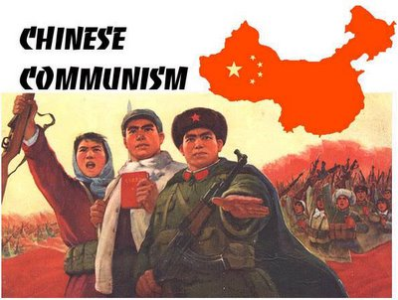
Who Lost China?
1949: After years of Civil War, the Chinese Communists under Mao Zedong take power from the under Chiang Kai-Shek.
Nationalists flee to Taiwan and create their own nation – a dispute still unresolved
US backs the Nationalists, and politicians pledge to be “tough on Communism”

Slide 15
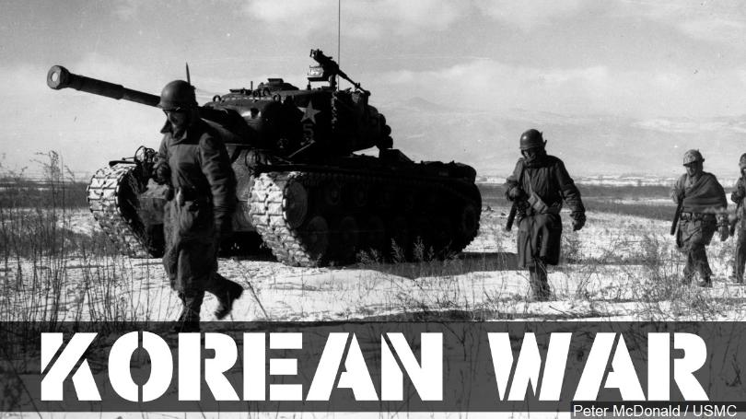

Slide 16
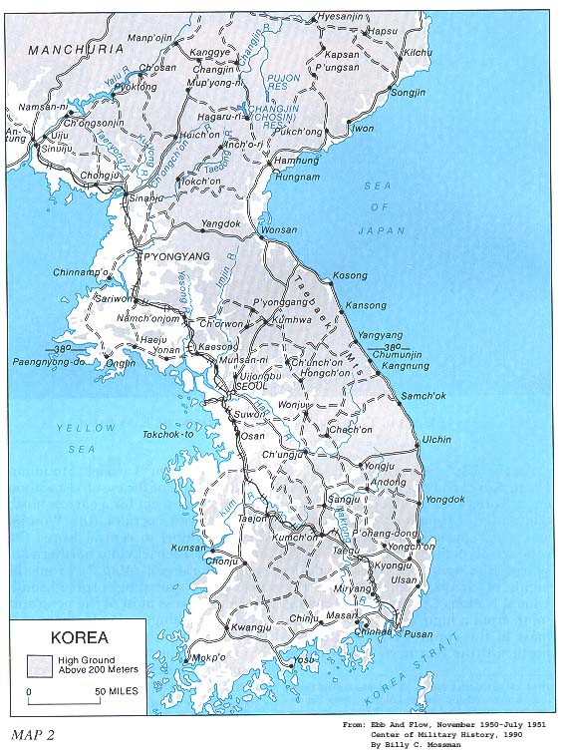
Korean War
June 1950: 90,000 North Koreans, backed by the Soviet Union, invade the American-backed Republic of South Korea. By August, United Nations troops have been driven to the southern tip of Korea.

Slide 17
Korean War
June 1950: 90,000 North Koreans, backed by the Soviet Union, invade the American-backed Republic of South Korea. By August, United Nations troops have been driven to the southern tip of Korea.
September 1950: Inchon Invasion. General Douglas MacArthur recaptures Seoul and North Koreans retreat back to the Chinese border by November.

Slide 18
Korean War
June 1950: 90,000 North Koreans, backed by the Soviet Union, invade the American-backed Republic of South Korea. By August, United Nations troops have been driven to the southern tip of Korea.
September 1950: Inchon Invasion. General Douglas MacArthur recaptures Seoul and North Koreans retreat back to the Chinese border by November.
November: Millions of Chinese troops invade Korea and drive US/UN troops back to the 38th parallel.

Slide 19
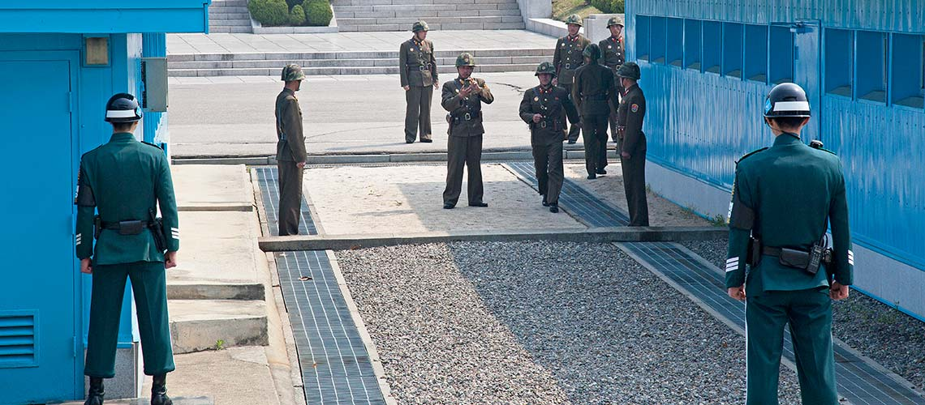
Korean War
April 1951: Truman fires MacArthur
1953: Armistice signed, with a demilitarized zone between the two sides.

Slide 20
22nd Amendment
No person shall be elected to the office of the President more than twice…
-Sets a limit of 2 terms for the President

Slide 21
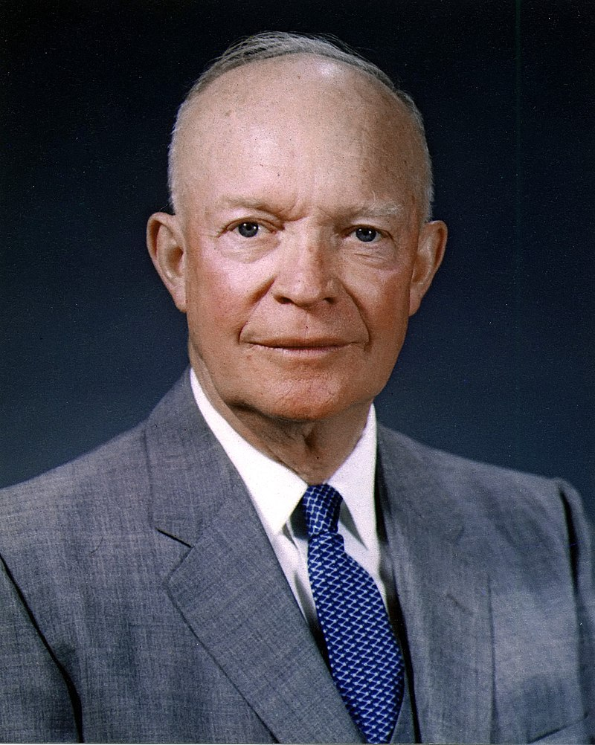
Dwight Eisenhower

Slide 22
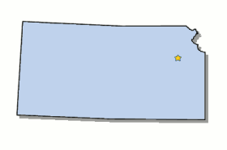
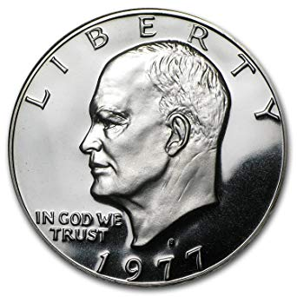
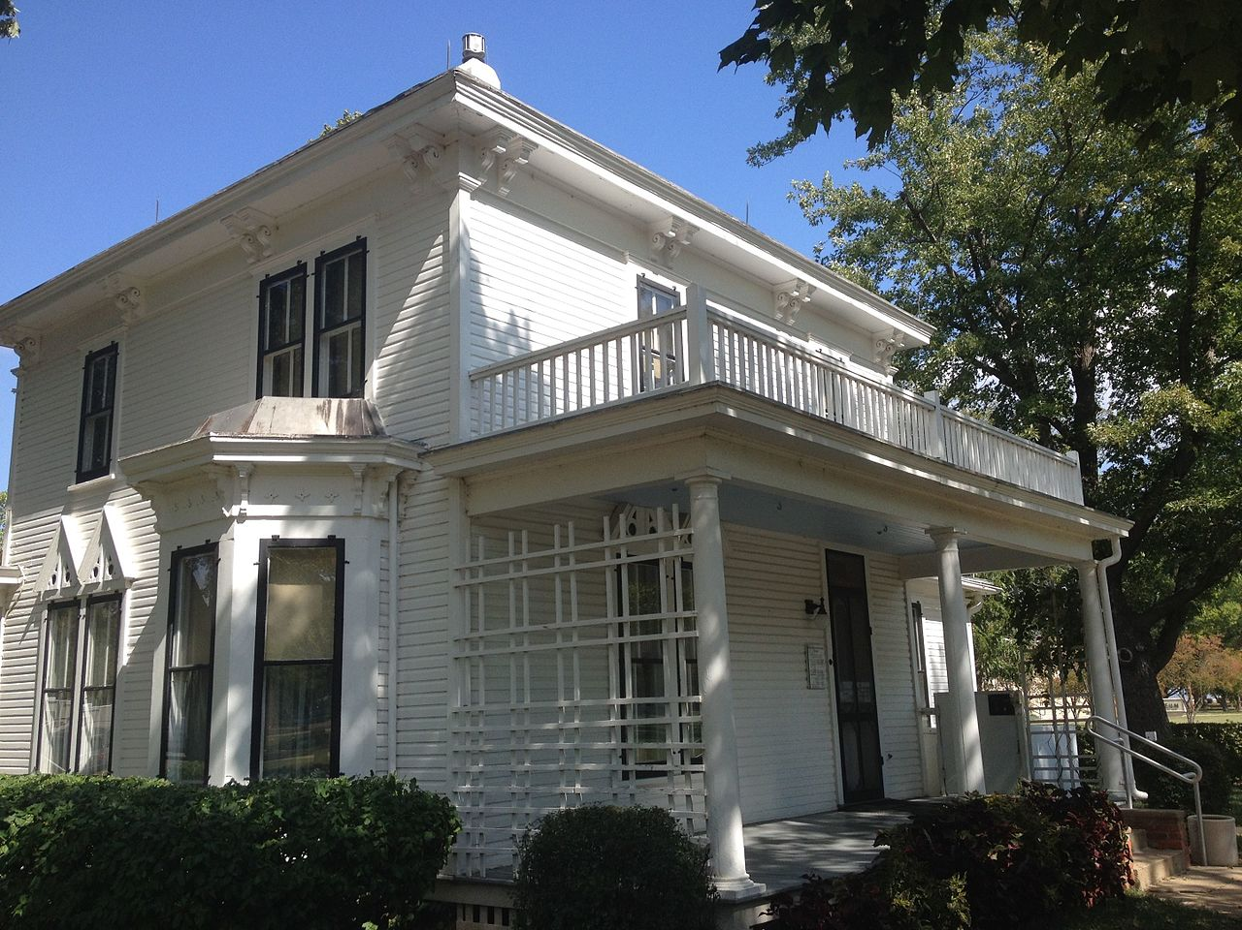
Elected in: 1952, 1956
President from: 1953-1961
Political Party: Republican
Home State: Kansas

Slide 23
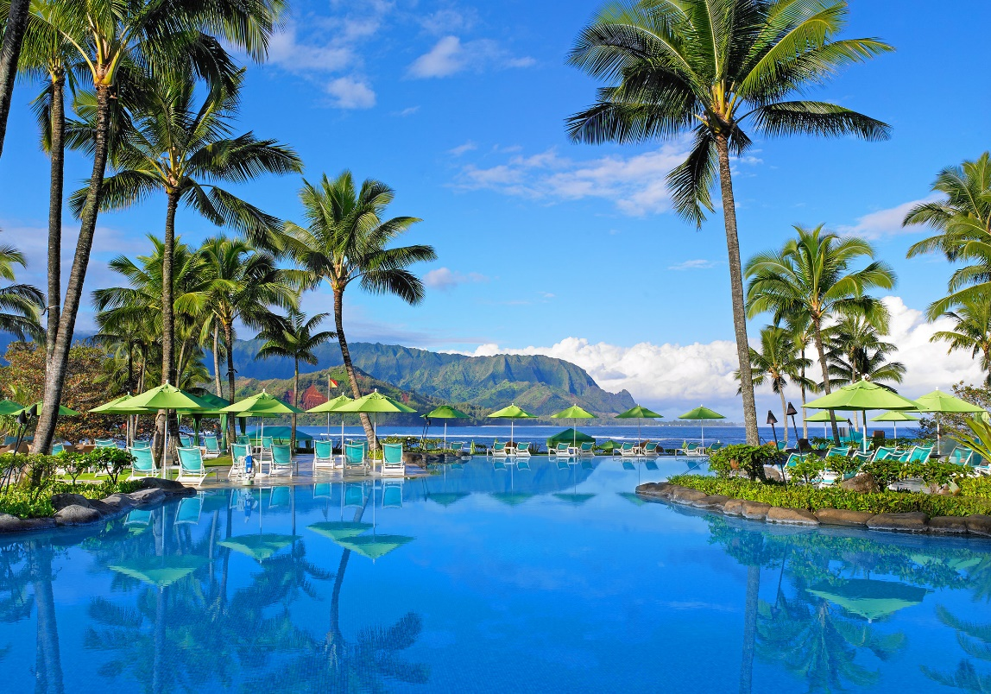
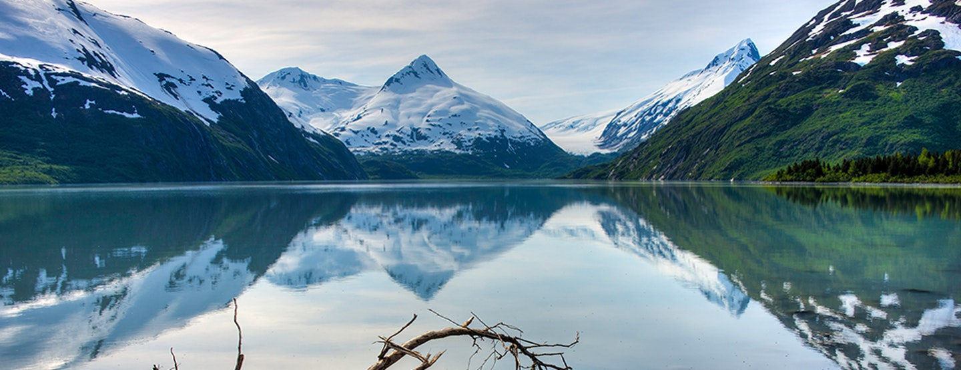
New States
49. Alaska
50. Hawaii

Slide 24
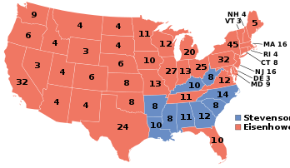
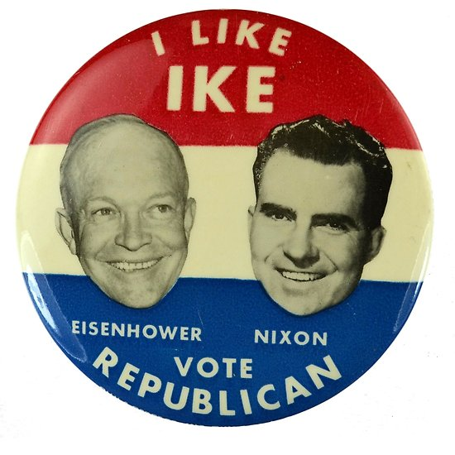
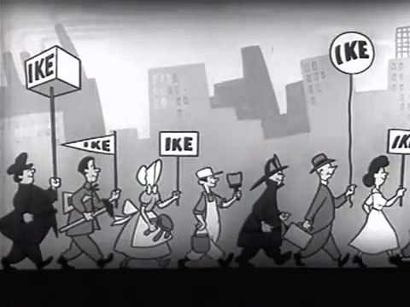
Election of 1952
Republican: 442
President: Dwight Eisenhower
Vice President: Richard Nixon
Democrat: 89
President: Adlai Stevenson
Vice President: John Sparkman

Slide 25
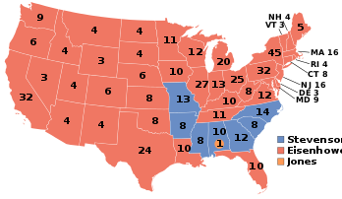
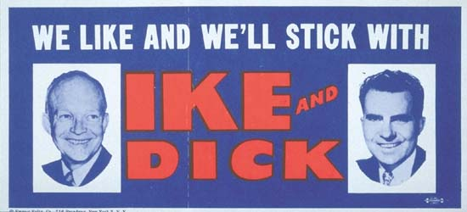
Election of 1956
Republican: 457
President: Dwight Eisenhower
Vice President: Richard Nixon
Democrat: 73
President: Adlai Stevenson
Vice President: Estes Kefauver

Slide 26
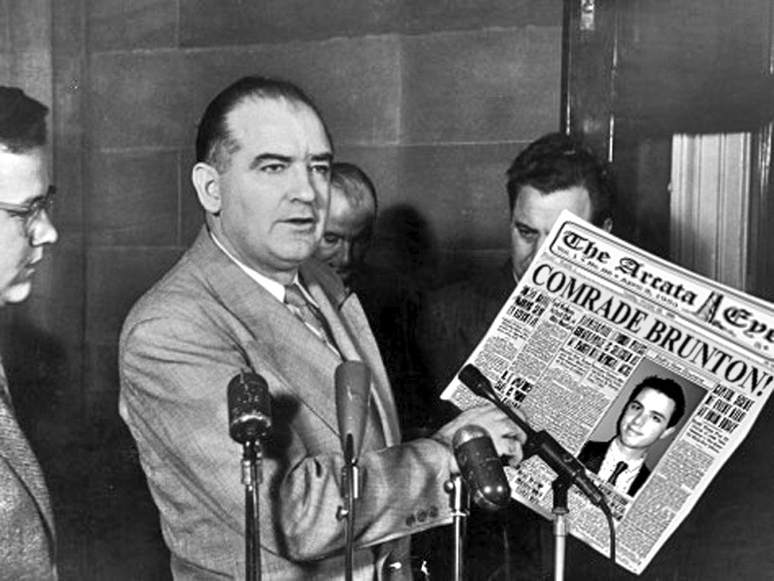
McCarthyism
Senator Joe McCarthy (R-Wisconsin) led a campaign against people he suspected were Communists – with little or no evidence – in the military, Hollywood, State Department, etc.
Many lost their jobs, but few people were willing to speak out against McCarthy.
He was finally reprimanded by the Senate in 1954 after going after the US Army.

Slide 27
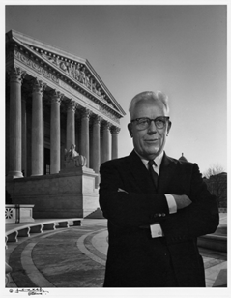
The “Warren Court”
Named for Earl Warren, the Chief Justice of the Supreme Court
Made many revolutionary and controversial decisions, such as:
Allowing “mixed” racial marriages
No official prayer in schools
“Miranda” rights & public defenders
A general right to privacy
Banning racial segregation (Brown v Board of Education)

Slide 28
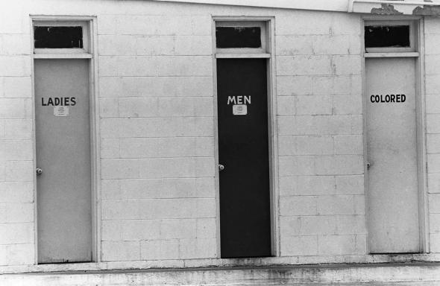
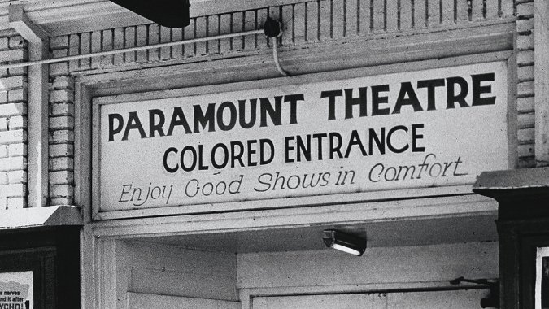
JIM CROW LAWS
Laws across the Southern US that enforced racial segregation.
Laws included maintaining “separate but equal” facilities such as train cars, seating on busses, bathrooms, water fountains, schools, etc.
Also designed to keep African Americans from voting (poll taxes, literacy tests)

Slide 29
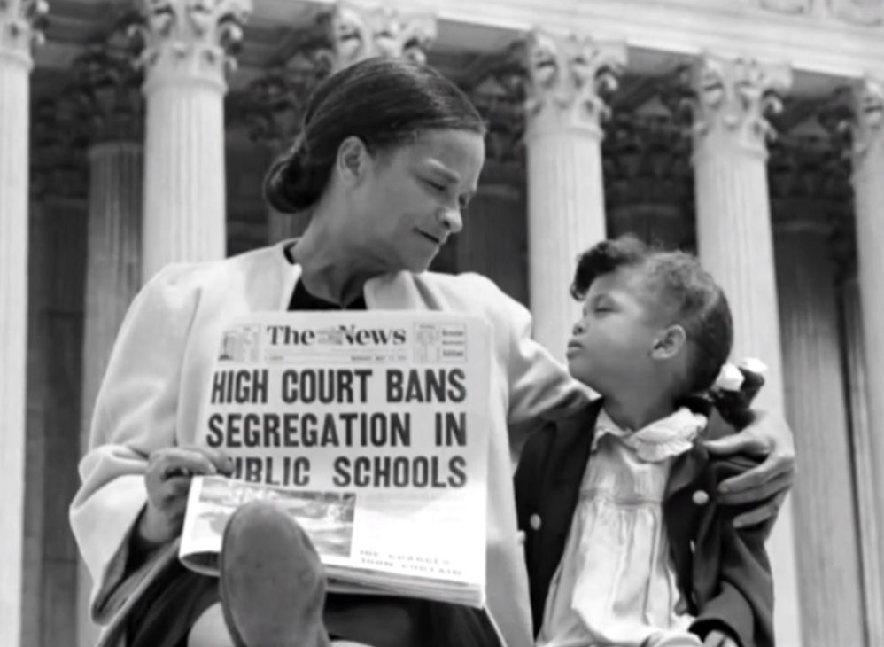
Brown v. Topeka Board of Education
Banned segregation in public schools
Overturned Plessy v. Ferguson, which allowed “separate but equal” facilities
Helped spark the modern civil rights movement

Slide 30
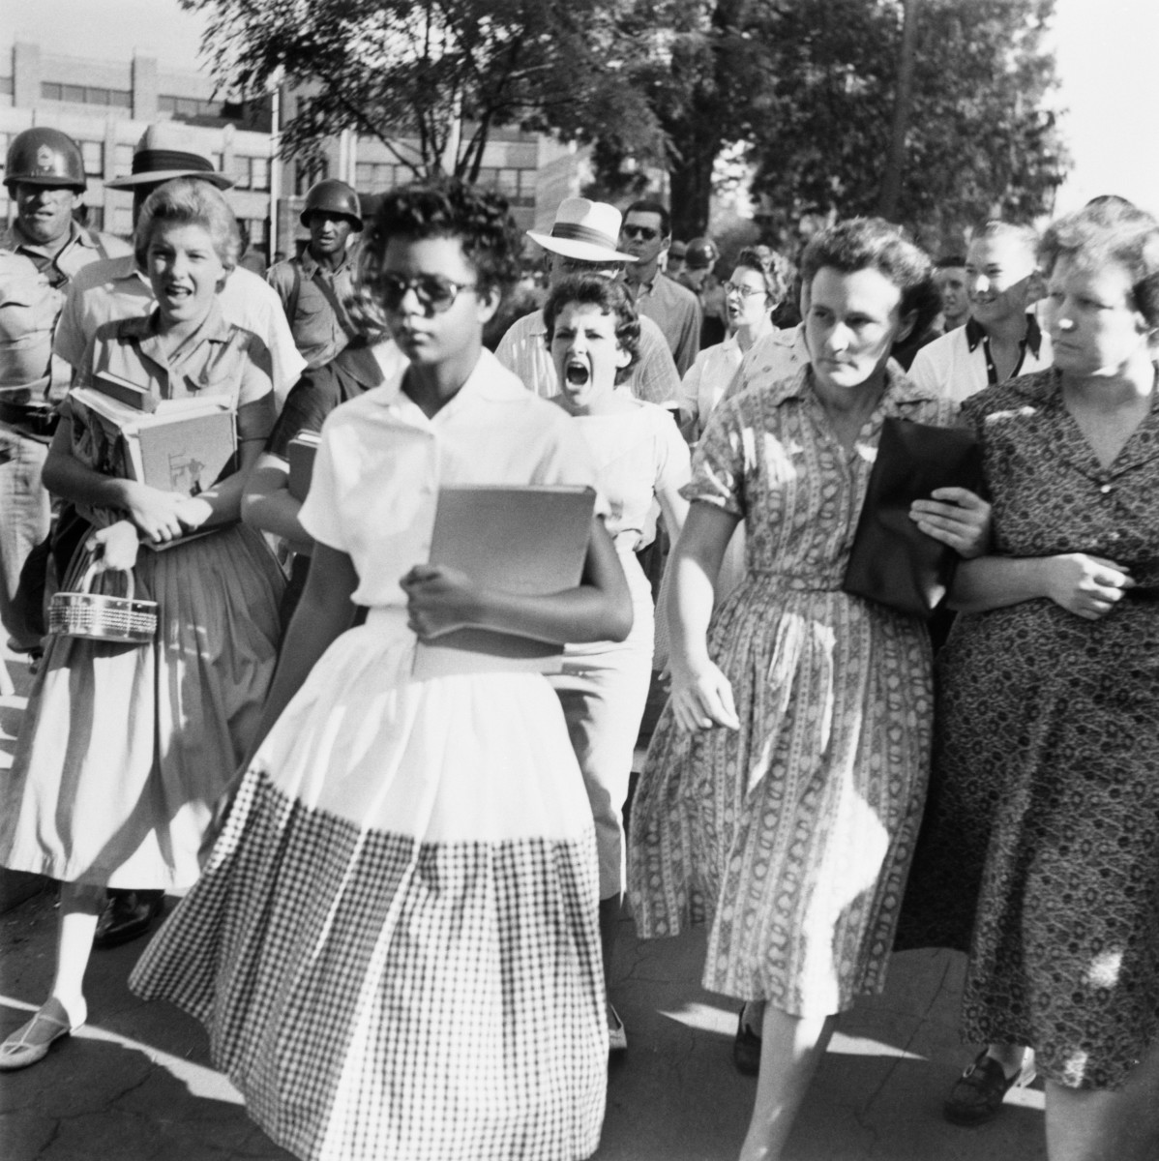
Little Rock Nine - 1957
Dispute over the integration of Little Rock (Arkansas) Central High School.
Governor Orval Faubus sent the National Guard to keep black students from entering.
After weeks of angry protests, President Eisenhower sent in US Army troops to protect the students as they went to school.

Slide 31
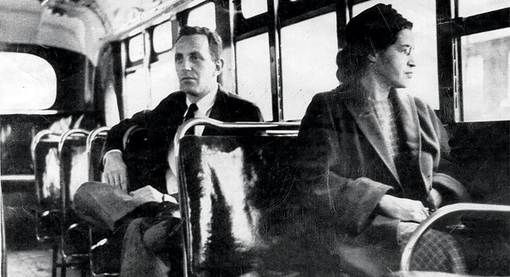
Montgomery Bus Boycott
Rosa Parks arrested after refusing to give up her seat at the front of a segregated Montgomery (Alabama) city bus.
A boycott of the bus system led by local minsters – including Rev. Martin Luther King Jr – by African Americans lasted over a year.
In 1956 the Supreme Court ruled against segregated transportation systems.

Slide 32
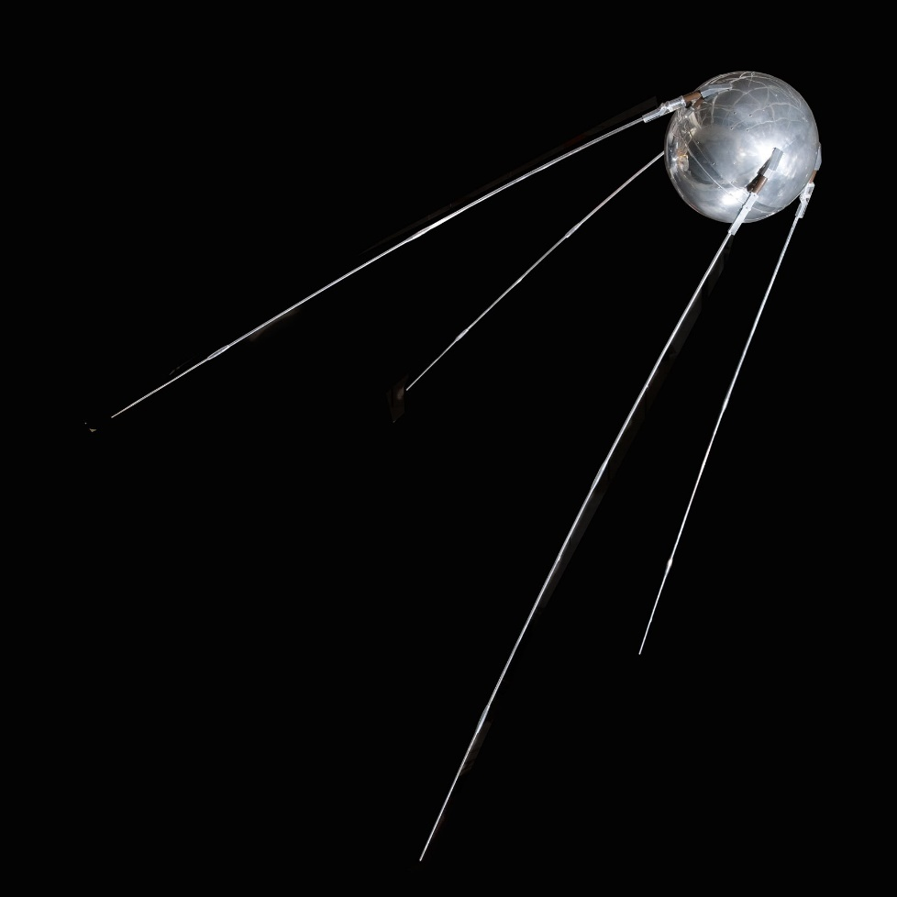
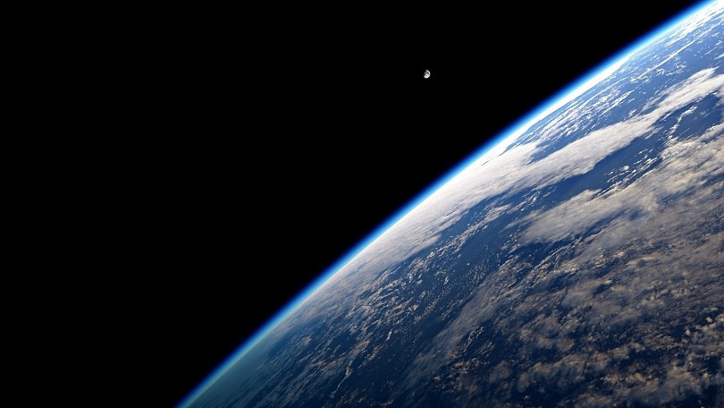
SPUTNIK
In 1957 the Soviet Union launched Sputnik, the first man-made object in space.
This launched the “Space Race” as the US attempted to keep up and surpass the Soviet Union’s advances.

Slide 33
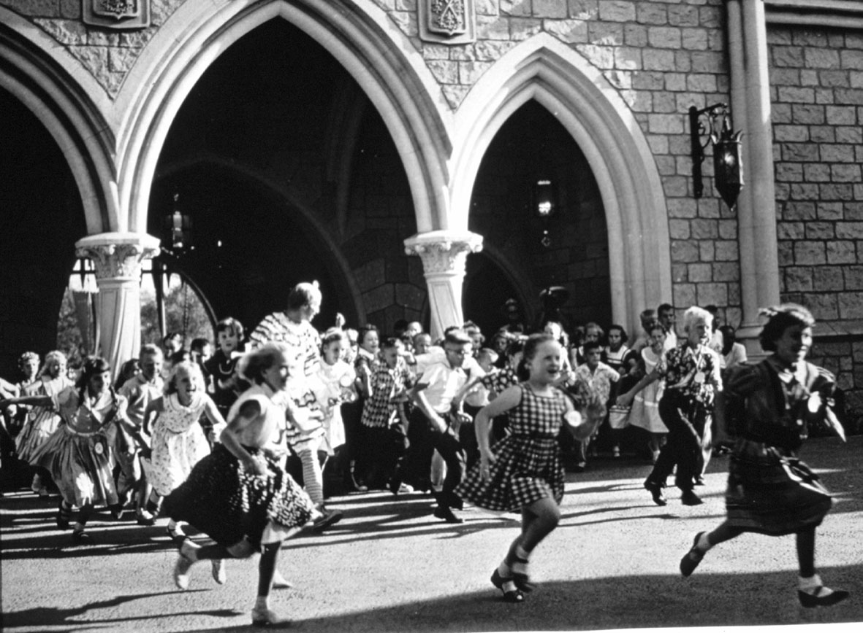
Pop Culture in the 1950s
Baseball Integrated (starting with Jackie Robinson in 1947)
Rock and Roll Music: Elvis, Bill Haley & Comets, Buddy Holly, Chuck Berry
TV shows: Mickey Mouse Club, I Love Lucy, Gunsmoke
Movie Stars: James Dean, Marilyn Monroe, John Wayne, Doris Day

Slide 34
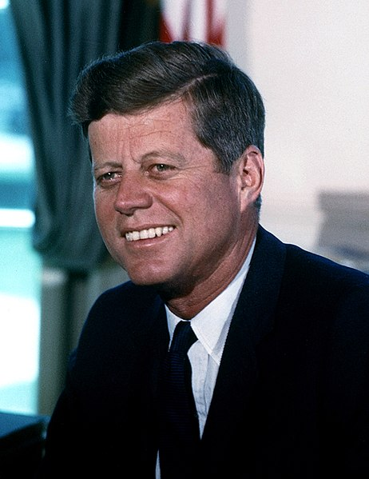
John F. Kennedy

Slide 35
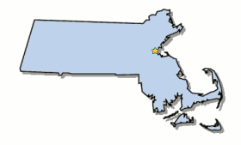
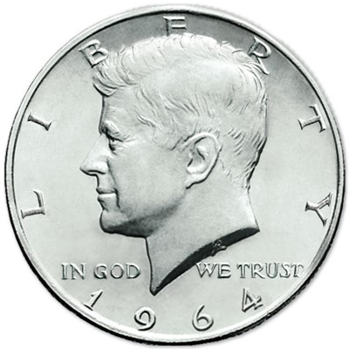
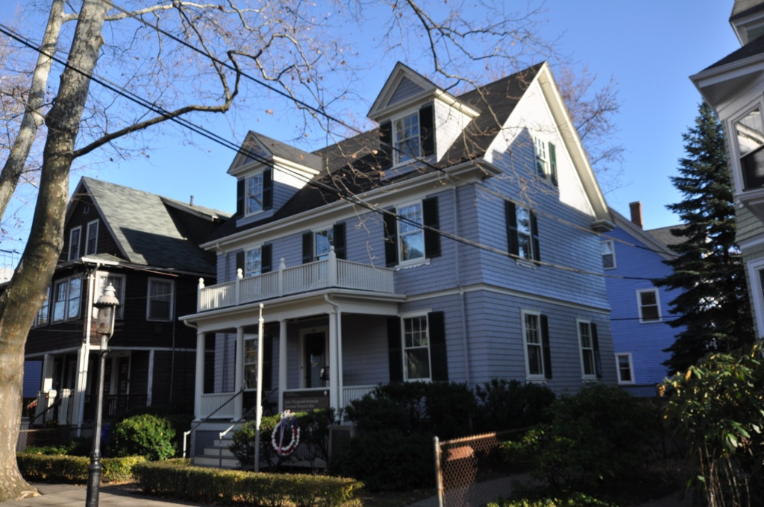
Elected in: 1960
President from: 1961-1963
Political Party: Democrat
Home State: Massachusetts

Slide 36
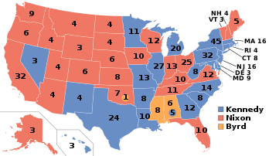
Election of 1960
Democrat: 303
President: John F. Kennedy
Vice President: Lyndon Johnson
Republican: 219
President: Richard Nixon
Vice President: Henry Cabot Lodge

Slide 38
23rd Amendment
The District constituting the seat of Government of the United States shall appoint in such manner as the Congress may direct:
A number of electors of President and Vice President equal to the whole number of Senators and Representatives in Congress to which the District would be entitled if it were a State, but in no event more than the least populous State
- Gives voting rights in Presidential Elections to residents of Washington, DC

Slide 39
The Cuban Missile Crisis
In 1959 Fidel Castro launched a Communist Revolution, took over Cuba and became allies with the Soviet Union.
All attempts by the US to eliminate Castro failed – including the Bay of Pigs invasion.
In 1962 the USSR attempted to place nuclear missiles in Cuba.
Kennedy blockaded Cuba but refused to attack – and after 13 intense days a deal was made and the missiles removed.

Slide 40
The Space Race
In 1961 the USSR put the first man in space – Yuri Gagarin.
Three weeks later NH native Alan Shepard became the first American in space (Project Gemini)
In 1962 John Glenn became the first American to orbit the Earth.
Kennedy pledged to put an American on the Moon by the end of the 1960s.

Slide 41
Civil Rights
May 1961: The Freedom Riders – a mixed group of blacks and Northern whites – were attacked as they made their way by bus into the South to protest for Civil Rights.
June 1963: Medgar Evers, a civil rights activist, is murdered in Mississippi. Trials of his killer, Byron de la Beckwith, are repeatedly deadlocked by all-white juries.

Slide 42
March on Washington
Massive protest and demonstration in Washington DC in August 1963 to demand equal rights for African Americans.
250,000 people attend
Most iconic moment is Martin Luther King’s “I have a Dream” speech
12.25

Slide 43
Berlin Wall
East Germany and USSR began building the concrete barriers to isolate West Berlin in 1961.

Slide 45
Assassination
On November 22, 1963 President Kennedy was assassinated by Lee Harvey Oswald in Dallas, Texas.
A few days later Oswald was killed in the Dallas Police Station by Jack Ruby, a night club owner.

Slide 46
Lyndon B. Johnson

Slide 47
Elected in: 1964
President from: 1963-1969
Political Party: Democrat
Home State: Texas

Slide 48
Election of 1964
Democrat: 486
President: Lyndon Johnson
Vice President: Hubert Humphrey
Republican: 52
President: Barry Goldwater
Vice President: William Miller
“Extremism in defense of liberty is no vice. Moderation in pursuit of justice is no virtue.” – Barry Goldwater

Slide 49
Civil Rights Issues
Civil Rights Act of 1964: Illegal for employers to discriminate due to race and ended racial segregation.
August 1965: Watts Riots in Los Angeles. 34 dead, 4,000 arrested
Jonathan Daniels killed in Alabama
February 1965: Malcolm X killed
Voting Rights Act of 1965: Outlawed literacy tests and other discriminatory practices in voting. Massive voter drives across the South

Slide 50
24th Amendment
The right of citizens of the United States to vote in any primary or other election for President or Vice President, for electors for President or Vice President, or for Senator or Representative in Congress, shall not be denied or abridged by the United States or any State by reason of failure to pay any poll tax or other tax.
- Eliminates the poll tax as a requirement for voting

Slide 51
25th Amendment
Whenever the President transmits to the President pro tempore of the Senate and the Speaker of the House of Representatives his written declaration that he is unable to discharge the powers and duties of his office, and until he transmits to them a written declaration to the contrary, such powers and duties shall be discharged by the Vice President as Acting President.
- Sets the procedure for succession to the office of President if the sitting president is unable to serve, and steps to fill a vacant Vice Presidency.

Slide 53
Origins
After World War II, French Indochina fought for its independence. One leader was Ho Chi Minh, a Vietnamese Communist.
In 1954, the French were defeated, and independent Vietnam split into Communist supported North Vietnam, and American supported South Vietnam.
President Kennedy sent in advisors to help the South Vietnamese win

Slide 54
Gulf of Tonkin
In 1964, North Vietnam reportedly attacked US destroyers off the coast of Vietnam.
US Congress granted President Johnson the power to fight against the North Vietnamese. This essentially started the Vietnam War.

Slide 55
The Sides
United States
VS
Democratic Republic of Vietnam (North)
Republic of Vietnam (South)
Viet Cong (Communist Supporters in South Vietnam)

Slide 60
More Trouble in 1968
Martin Luther King assassinated in Memphis, TN on April 4. James Earl Ray pleads guilty and sentenced to 99 years.
Race Riots break out in 100 cities across America, especially Washington DC, Baltimore, Kansas City, and Chicago.
In June, Robert Kennedy, brother of President Kennedy and a Democratic Presidential candidate, is assassinated in Los Angeles by Sirhan Sirhan.
Violent riots and police actions in Chicago during the Democratic Convention, Summer 1968

Slide 61
The Great Society

